Slide 1

MaintainATSPlan
Terry.Yin 2014-06

Slide 2
维护程序主要分为两层:
1.Gloabal表资料
(提供各种默认设置或参数)
2.Topo表资料维护
(设置测试计划的详细资料)
Gloabal表资料
Topo表资料

Slide 3
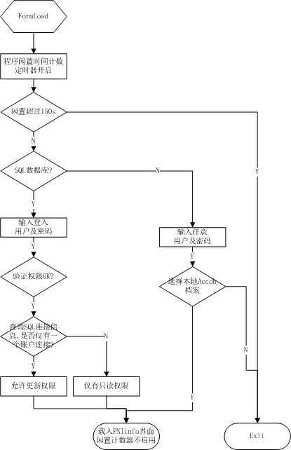
Login Interface

Slide 4
Total Follw Chart
input
Edit/Delete/Add
Output
DataBase
GUI
Select
ProductionType
GlobalMSADefintionInf
ProductioType
List
TopoTestPlan
Select
ProductionName
GlobalManufactureMemory
ProductioType
List
TopoTestControll
TopoTestPlan
GlobalAllAppModelList
TopoTestModel
TopoTestControll
TopoEquipment
GlobalAllTestModelList
TopoTest
Parameter
GlobalTestModelParamterList
TopoEquipment
TopoTestModel
TopoEquipmentParameter
GlobalAllEquipmentList
TopoEquipmentParameter
TopoTest
Parameter
GlobalAllEquipmentParamterList
Update To DataBase

Slide 5
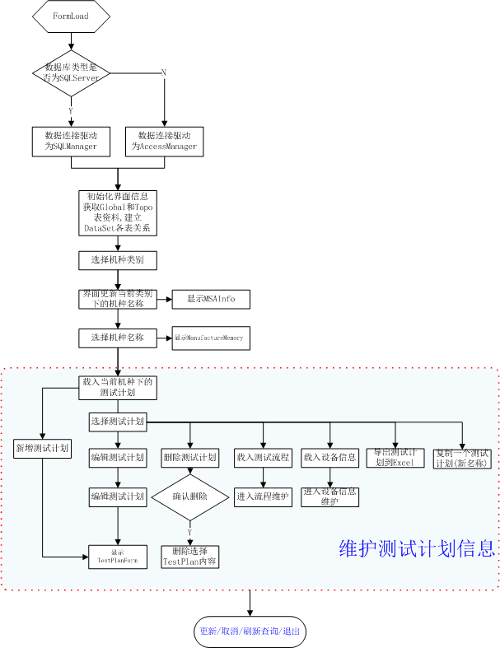
PNInfoForm

Slide 6
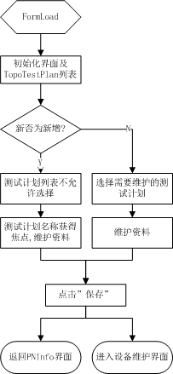
TestPlanForm

Slide 7
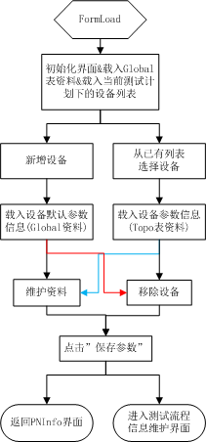
EquipmentForm

Slide 8
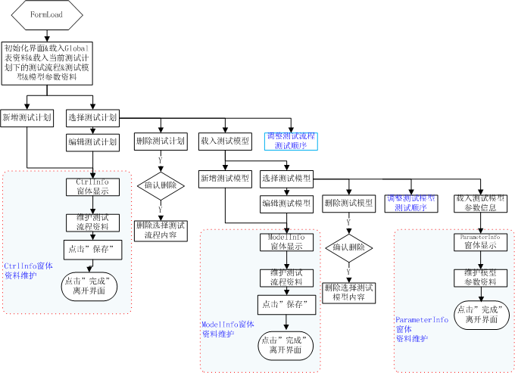
ALL TestControlInfo

Slide 9
流程文件

Slide 10
Thanks!!!

